Slide 1




Web Project
Workers
workers.akmuseum.net
Abdullah Rafiq
FA22-BCS-006

Slide 2

Agenda
About the Project
Identified Problem
Solution Overview
Key Features
Services
Impact on SDGs
Testimonials

Slide 3


About the Project
Mission: Empower individuals by connecting them with trustworthy local workers for everyday tasks.
Vision: Create a seamless platform that addresses the gap between service demand and availability in local communities.

Slide 4


Identified Problem
Lack of trusted and authentic workers for household or outdoor tasks.
Difficulty in finding skilled workers without proper market knowledge.
Limited accessibility to reliable resources in local areas.

Slide 5
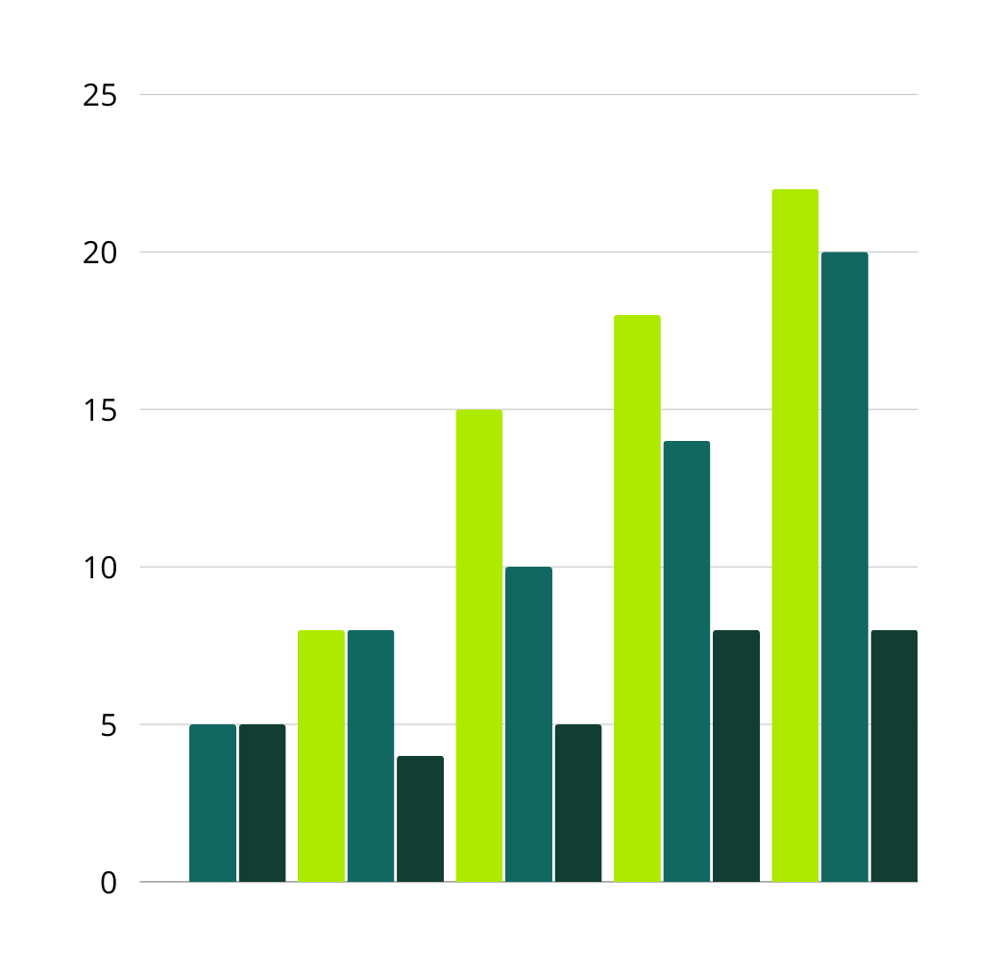
Solution Overview
Platform Description:
A web-based platform connecting people with local workers for various services.
How It Works:
Users search for workers by area and skill.
Workers list their services with profiles and reviews.
Secure hiring and payment options ensure trust and transparency
Outcome:
Efficient, reliable, and mutually beneficial connections.

Slide 6


Key Features
Register Workers
Easy registration process for workers to showcase their skills and availability.
Hire Workers
Users can effortlessly hire verified workers for household or outdoor tasks.
FAQ and Assistance
Dedicated FAQ section to answer common queries.
24/7 assistance to resolve user concerns.
Transparent Pricing
Clear and upfront pricing for all services, ensuring no hidden costs.

Slide 7

SDG
Decent Work and Economic Growth
Sustainable Cities and Communities
Promotes employment opportunities for local workers.
Enhances economic activity within communities.
Builds resilient communities by fostering local collaboration.
Strengthens trust and reduces dependency on external resources.
Reduced Inequalities
Equal access to opportunities for workers across different regions.
Providing visibility to skilled yet underrepresented workers.

Slide 8

Services
Connecting Communities with Local Workers
Worker Profiles
Verified profiles with comprehensive details, ratings, and skills.
Task-Specific Search
Easily locate workers based on task requirements and location.
Secure Hiring Process
Transparent and secure interactions between users and workers.
Payment & Feedback System
Seamless payment options and feedback for quality assurance.
Real-Time Updates
Track the progress of your task efficiently.
01
02
03

Slide 9

Testimonials
Customer Experience
Worker Experience
“Hiring a local electrician through this platform was incredibly easy. I felt secure knowing the worker was verified and highly rated!”
– Hadia, Okara
“I’ve gotten more jobs in the last month than I usually do in a year. This platform has changed my life.”
– Khaqan, Carpenter

Slide 10




THANK YOU
Workers
0322 5912989
abdullahrafiq463@gmail.com
Faisalabad Road, Okara

